Slide 1
Using Terra Dotta
Student Users

Slide 2
New Online Application System
Direct link: gcsu-sa.terradotta.com (but all links from GC hosted website also link to it)
Administrators use UNIFY credentials to login
  students will use UNIFY too
  Non-GC students will set up an account through the software
  PLEASE NOTE – the first time a student uses the site, they will need to find their program and click “apply now” not go through the log in procedures described later

Slide 3
New Online Application System
You can:
  Search for programs by country, region, language of instruction and more
  Track personal progress in completing application, orientation, evaluation, etc.
  Make payments online
  MUCH More!

Slide 4
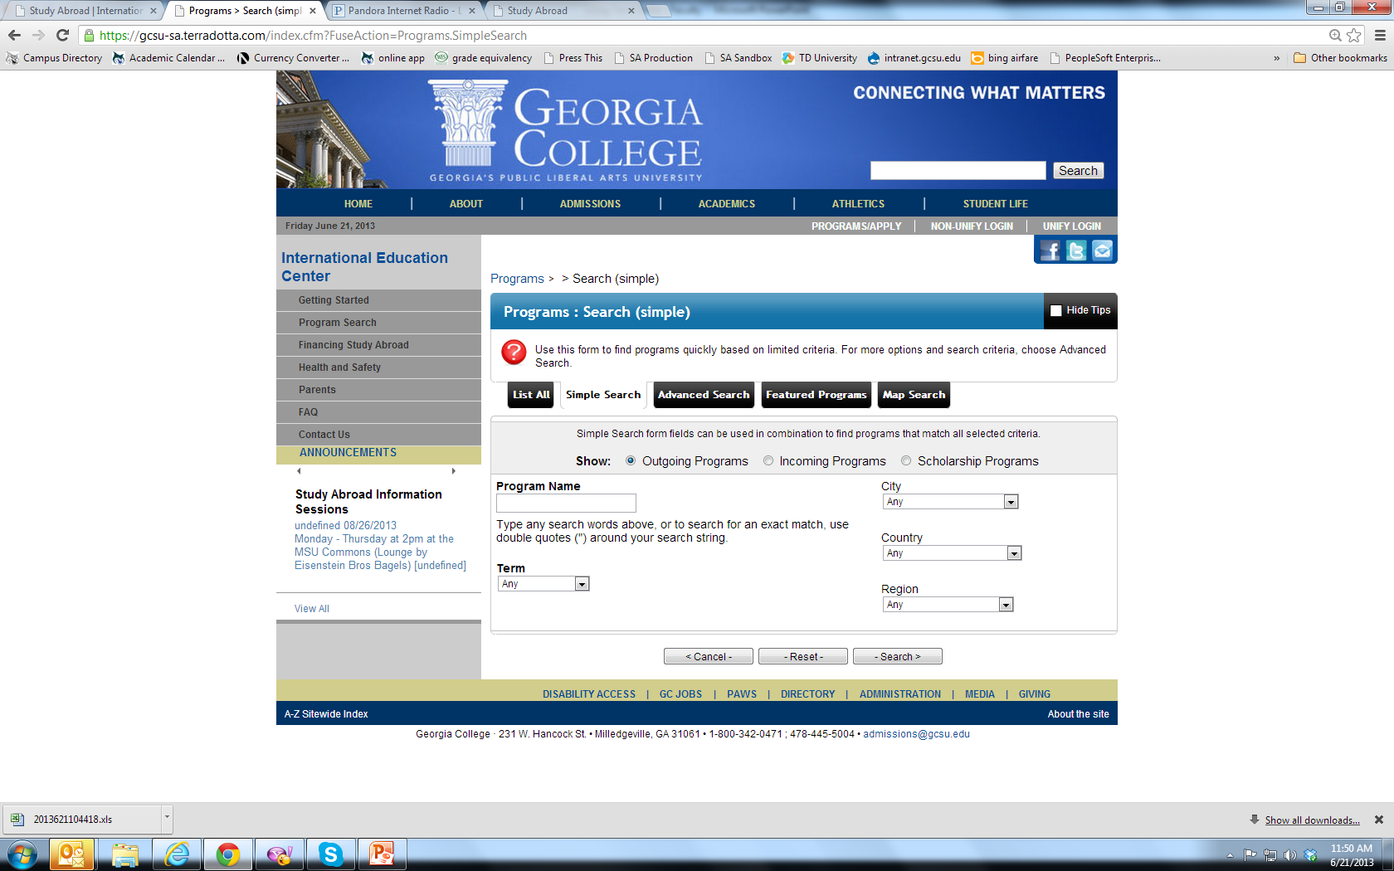
Program Search allows students to easily find programs that suit needs

Slide 5
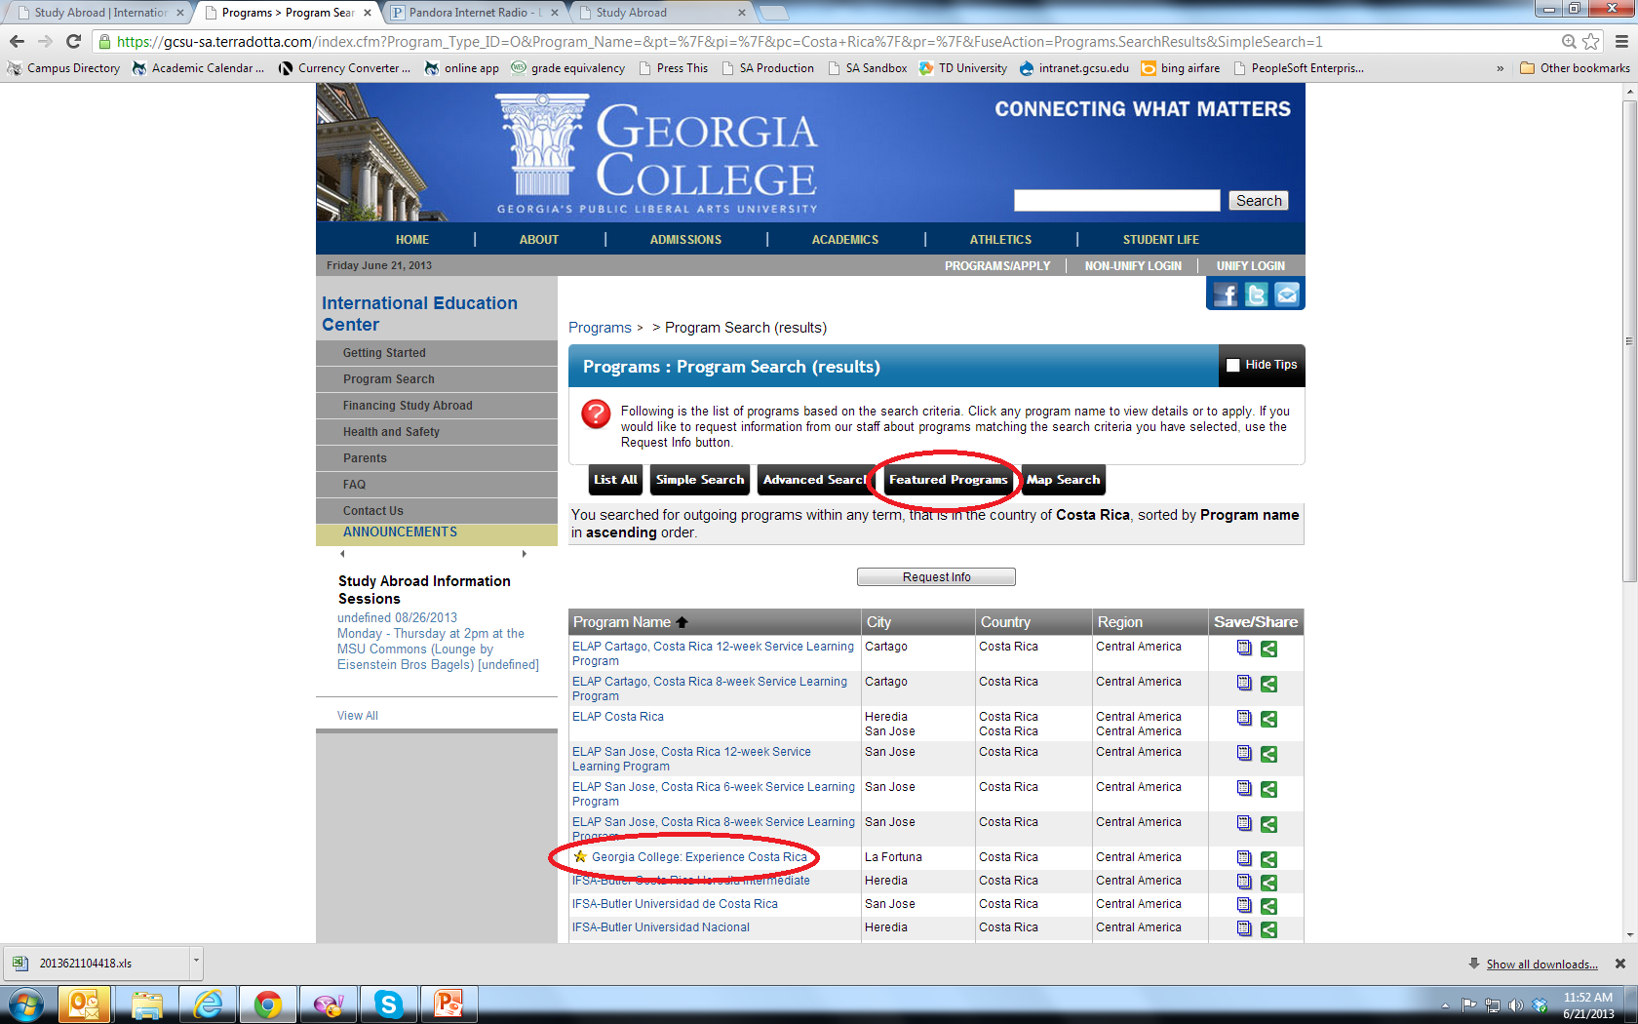
GC Faculty Led programs are “Featured Programs”

Slide 6
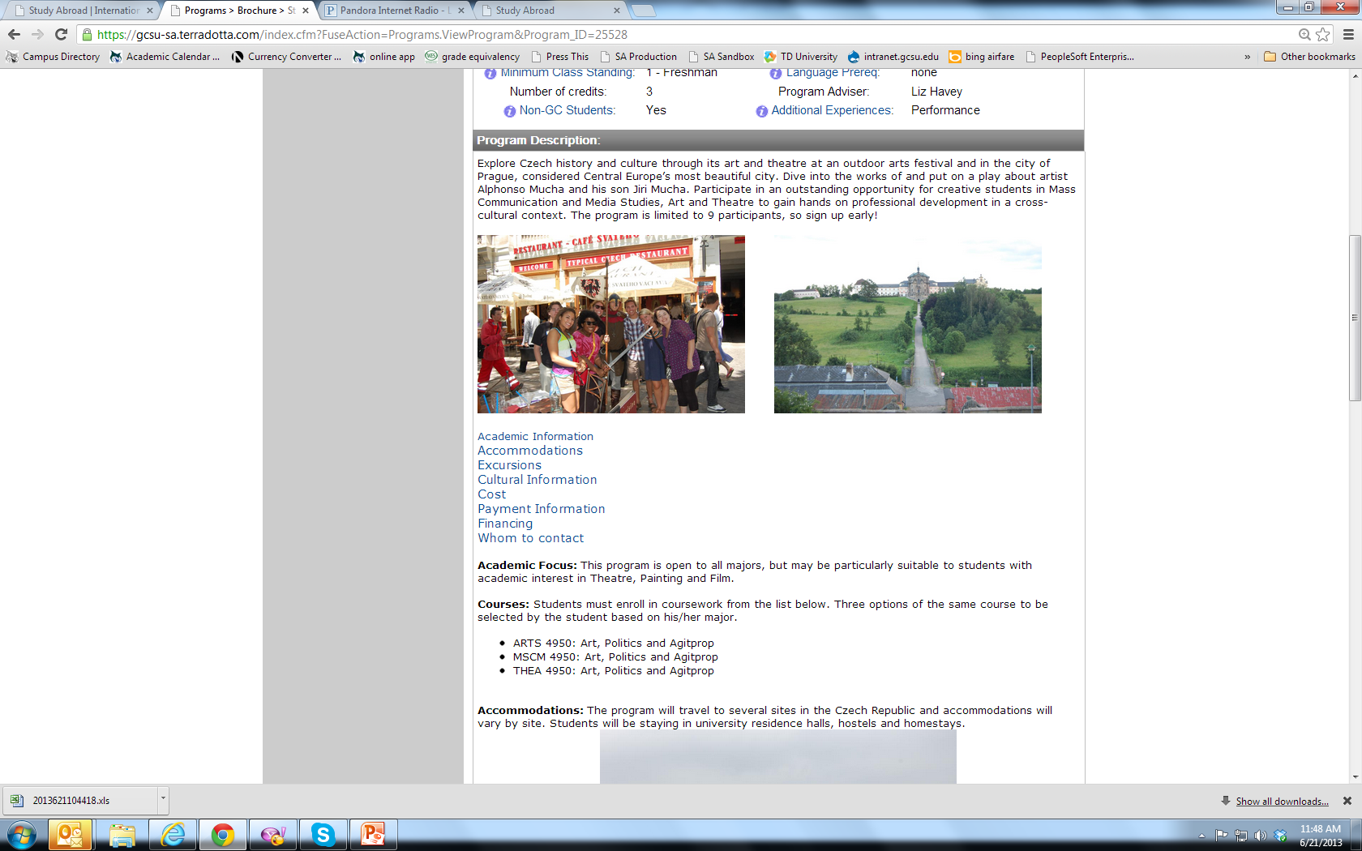
Each program will have its own page

Slide 7
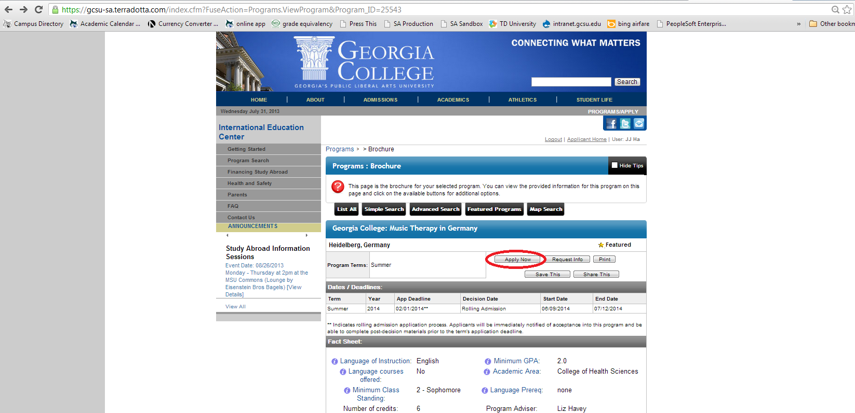
First time applicants select program of choice and click “apply now”

Slide 8
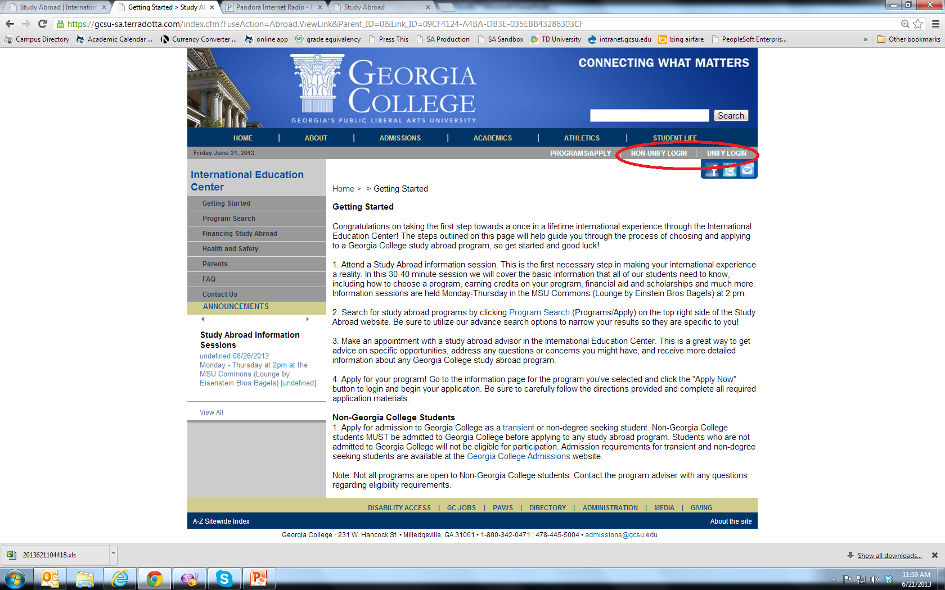
Return users can use the login links found at the top of every page

Slide 9
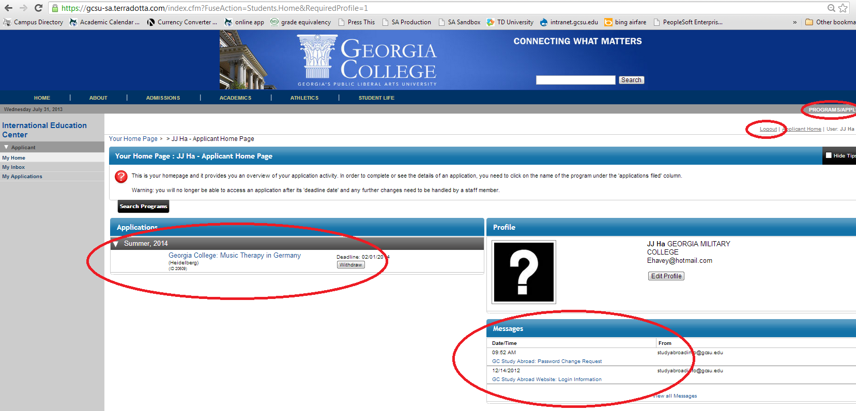
Applicant homepage – view applications, message/history log, search for programs, edit profile, etc.

Slide 10
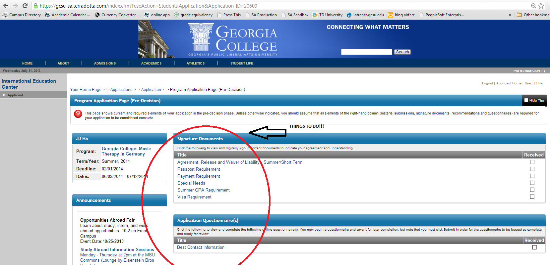
Application home page and tasks required

Slide 11
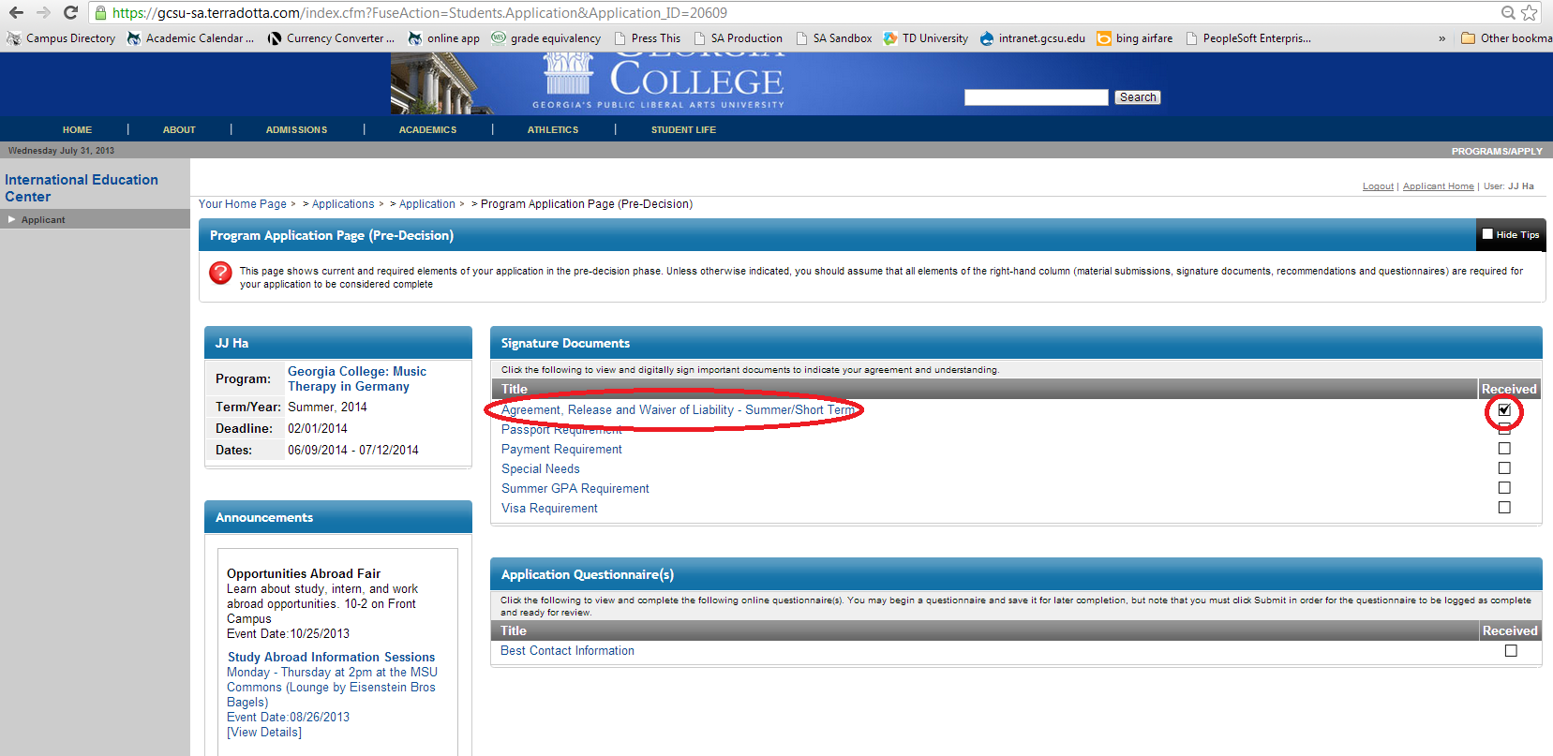
Completing tasks – click on item and follow instructions. When complete, you’ll see a check in the box!

Slide 12
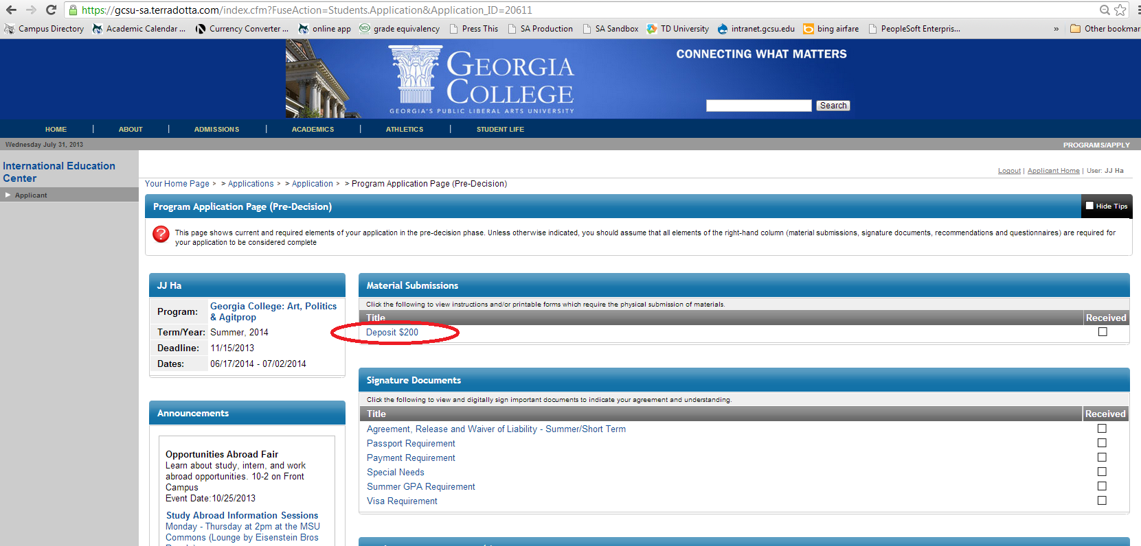
Making Payments

Slide 13
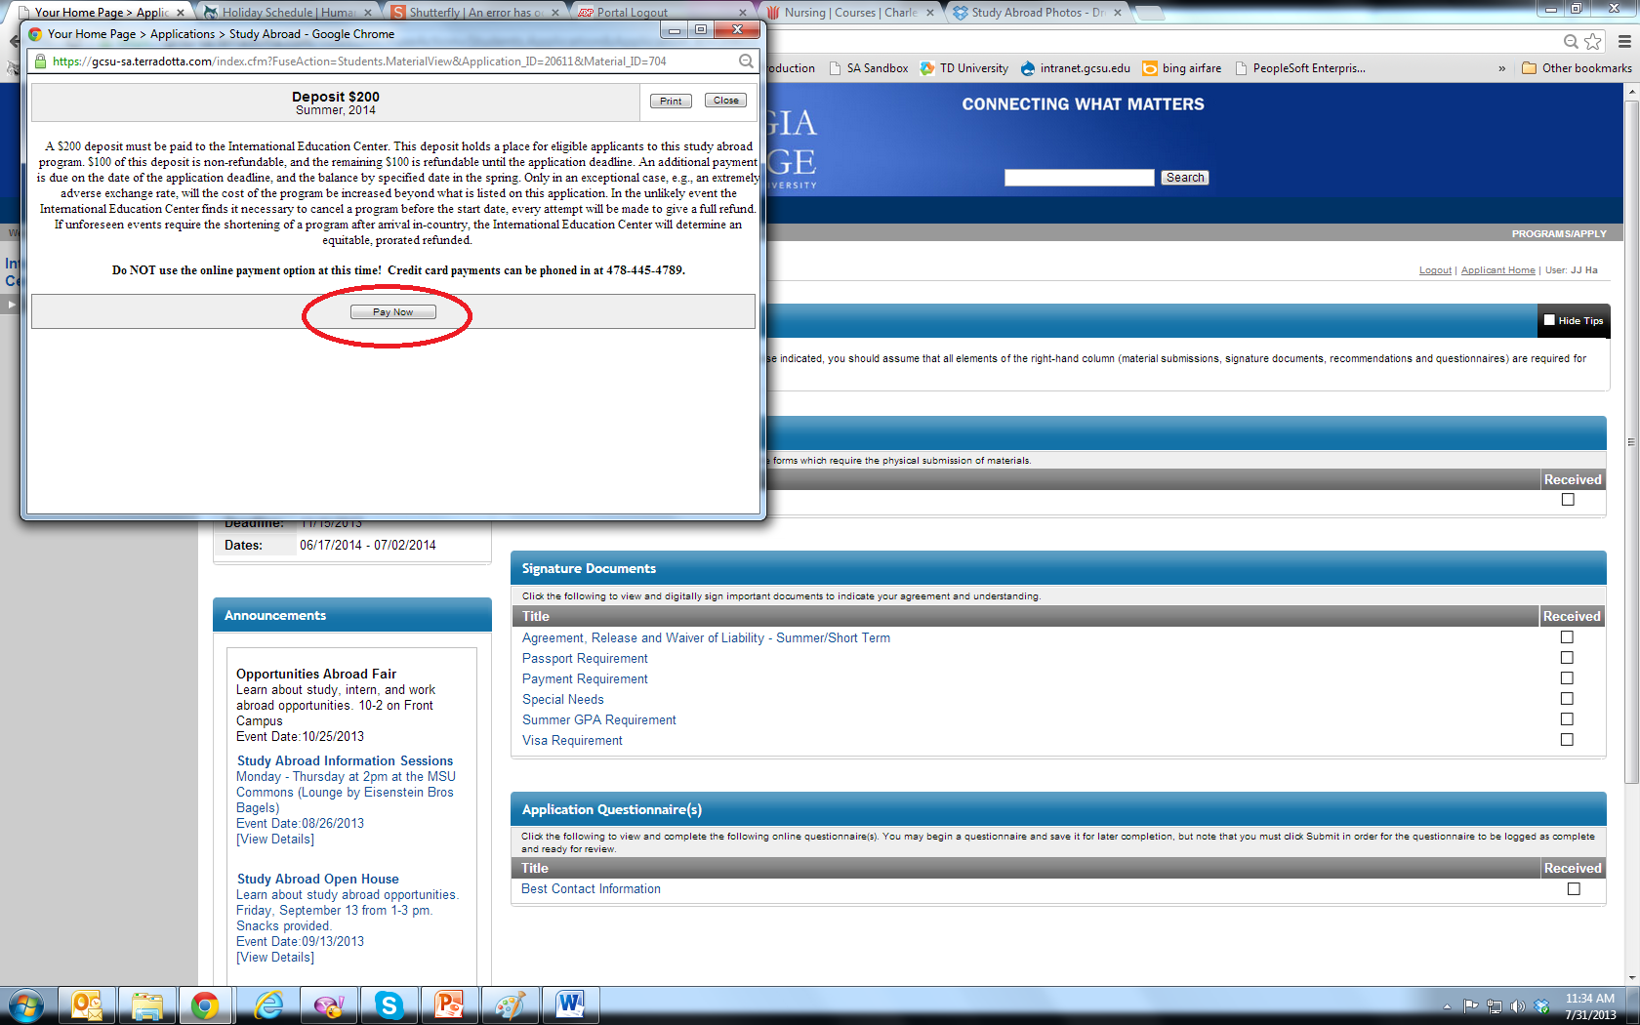
Payment Step 2

Slide 14
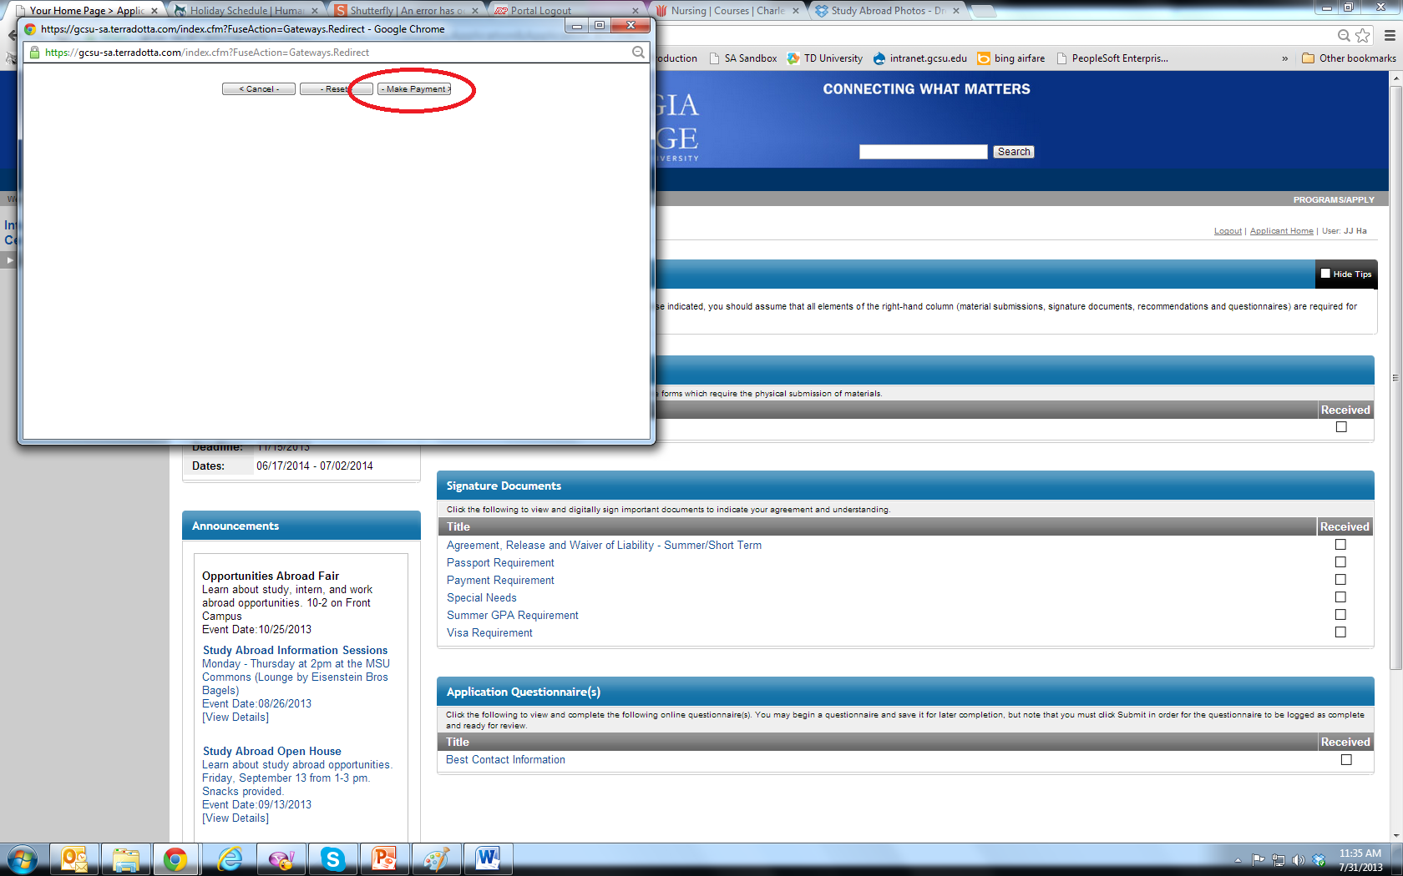
Payment Step 3

Slide 15
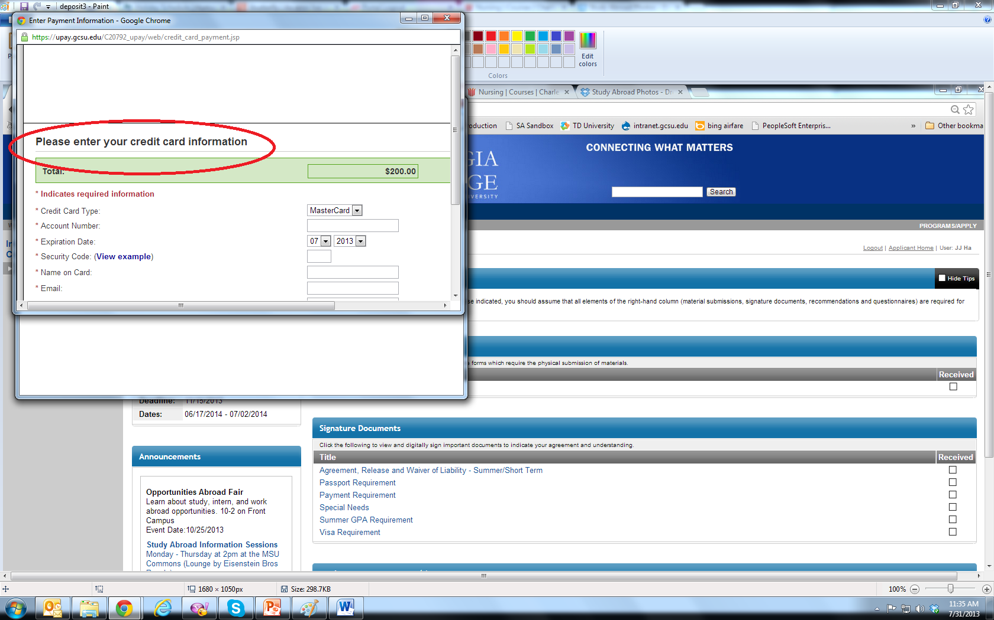
Last step to pay!

Slide 16
Payments via check, cash, or money order
Any payment other than credit or debit card must be submitted directly to the International Education Center
  Hours of operation 8am – 5pm Monday – Friday
  Mailing address:
    CBX 049, Georgia College & State University, Milledgeville, GA 31061
  Physical address:
    141 S. Clarke St., Milledgeville, GA 31061

